Slide 1

Midterm Defence JobNexus
(Job Portal Application)
Akriti Chapagain
Binaya Koirala

Slide 2
INTRODUCTION
Job Nexus is an upcoming mobile application that aims to improve the job search process.
Establishing partnerships with local organizations to provide job vacancies for semi-skilled manpower and entry-level positions.
Empowering individuals through skill development and career opportunities.

Slide 3
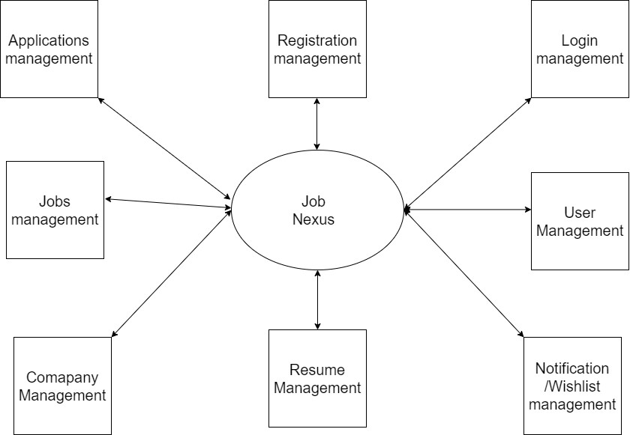
System Designs

Slide 4
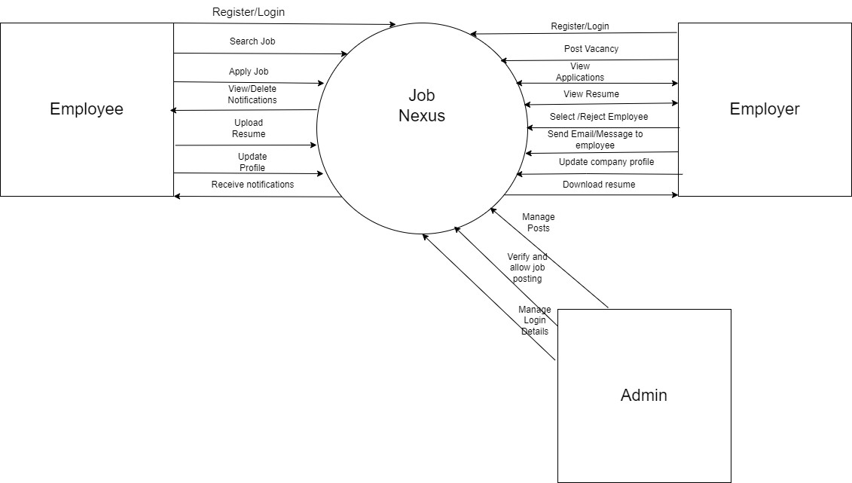

Slide 5
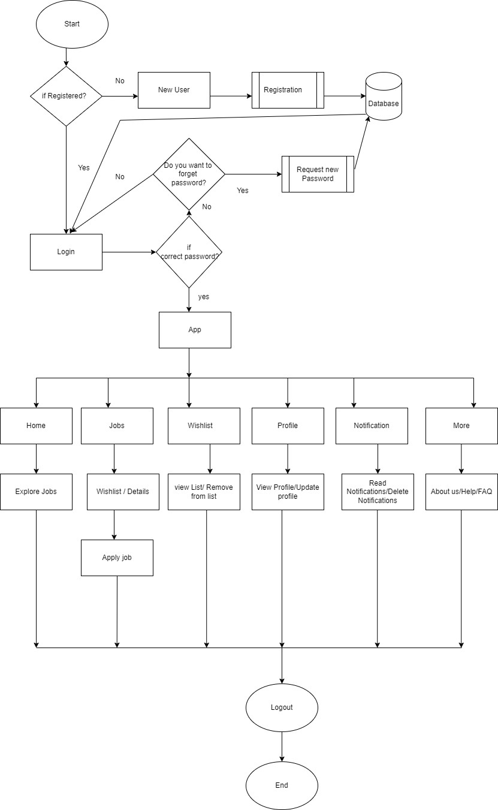

Slide 6
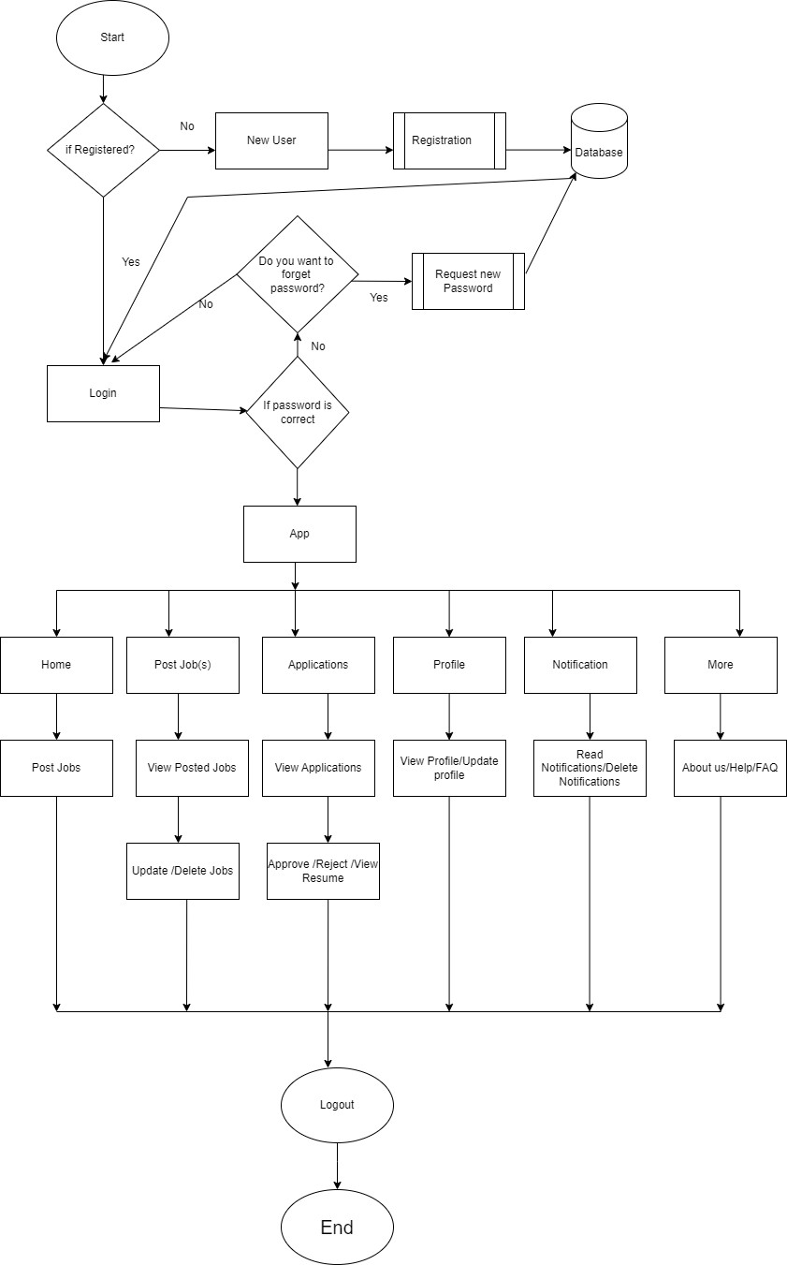

Slide 7
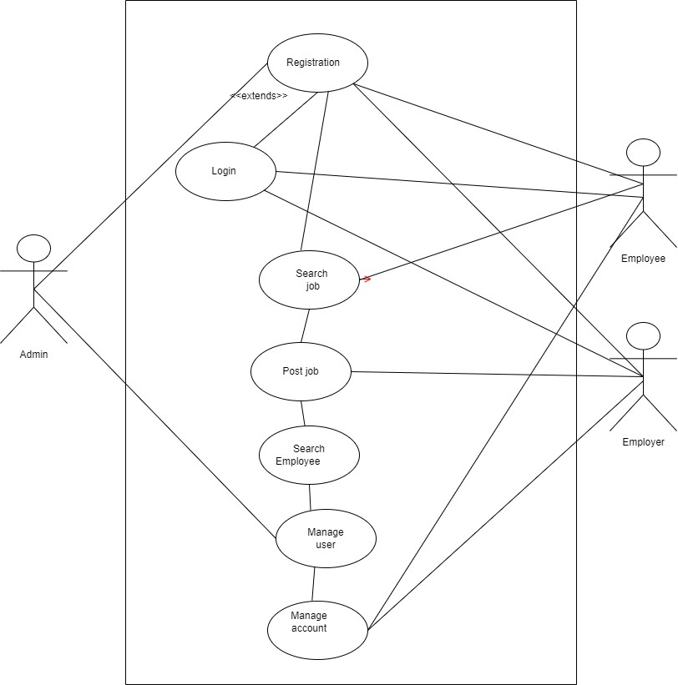

Slide 8
Completed tasks
Login Sign up

Slide 9
Remaining Tasks
Backend:
View and Downlaod Resume
Email /Notification Send
Job Post from Backend

Slide 10
Bottlenecks

Slide 11
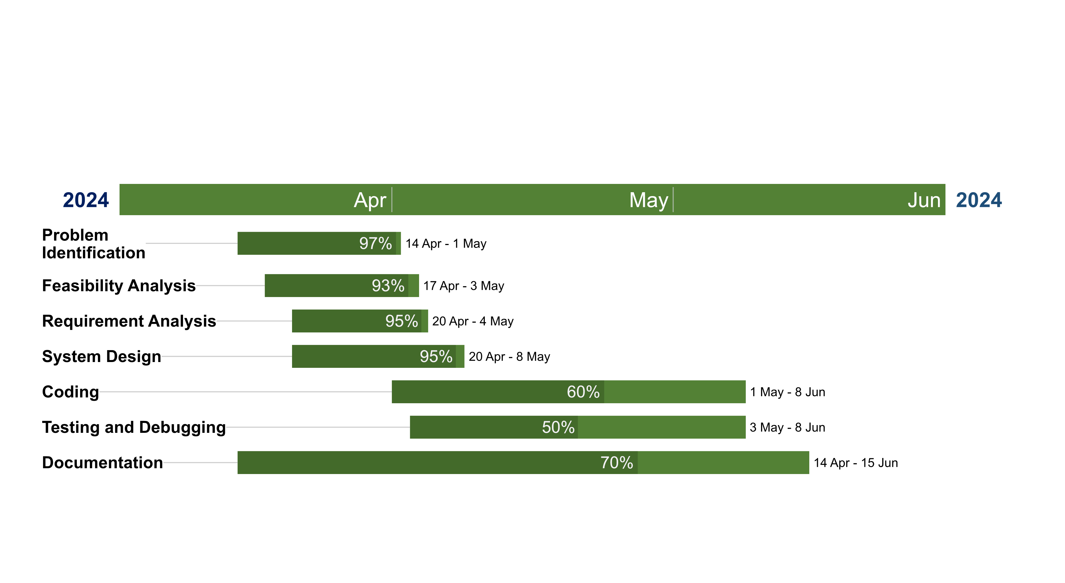
GANTT CHART

Slide 12


Slide 13
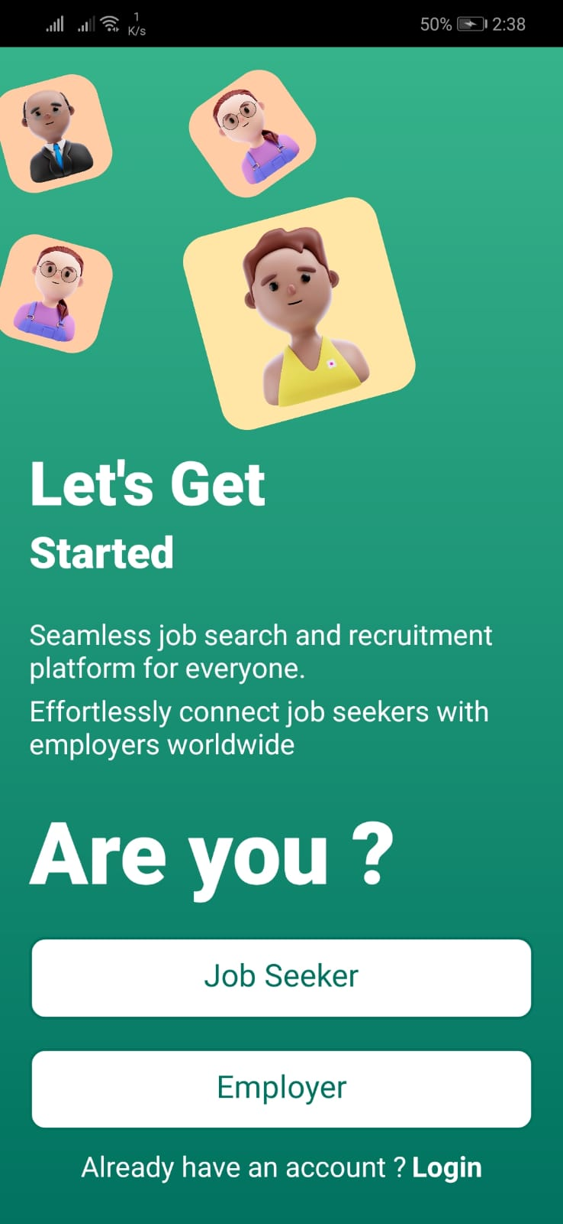
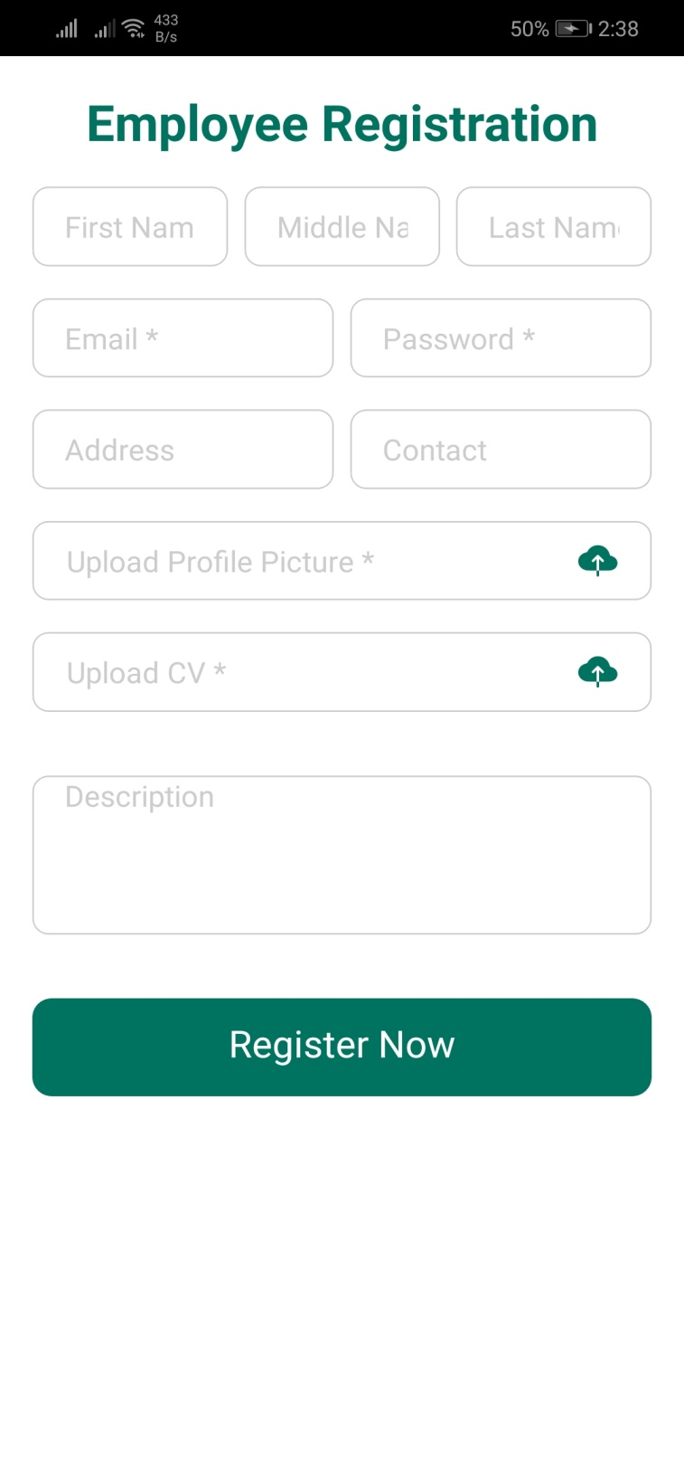
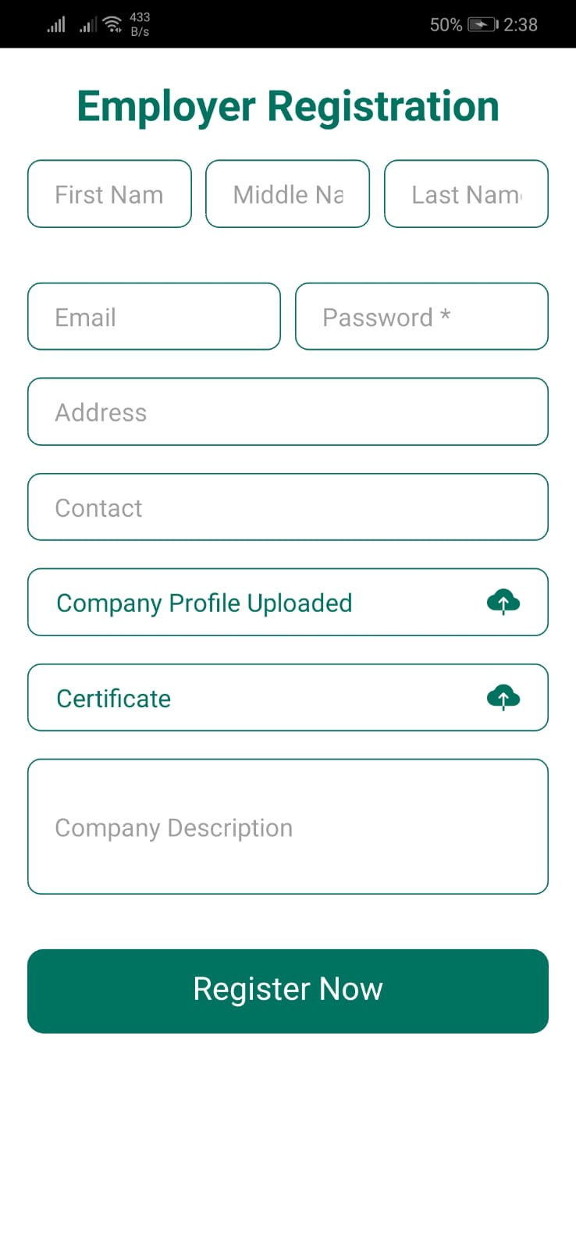

Slide 14
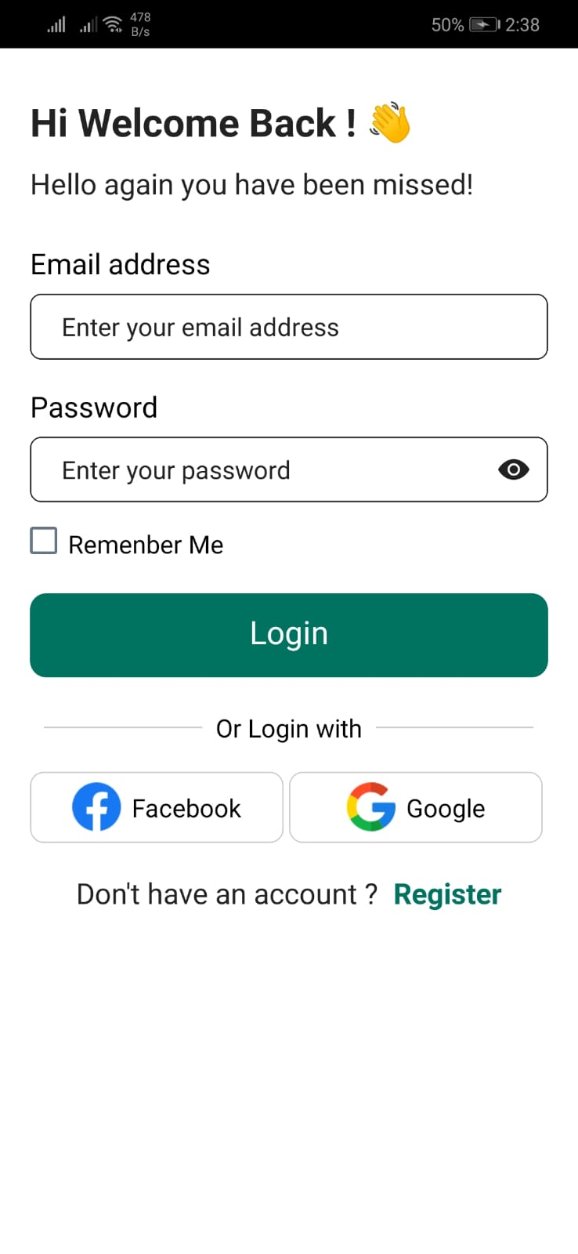
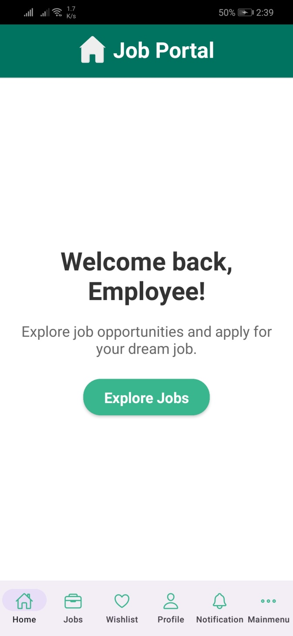
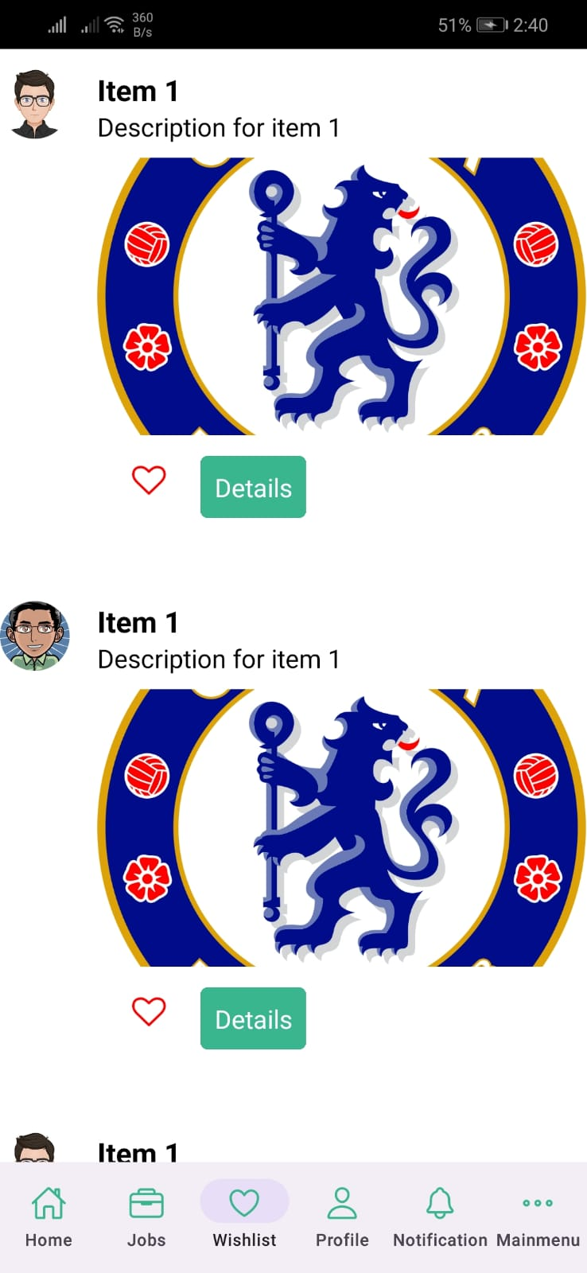

Slide 15
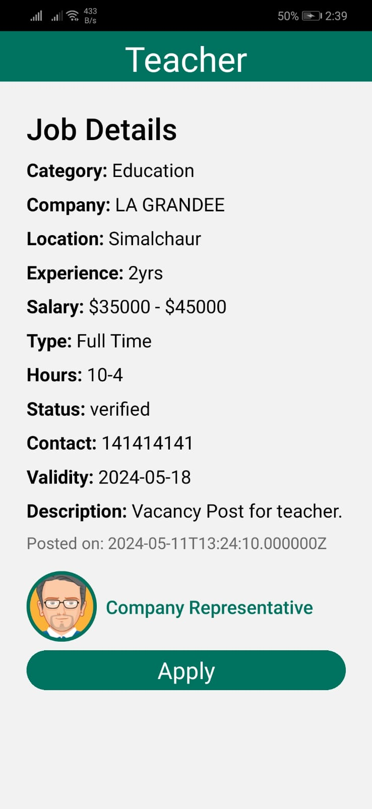
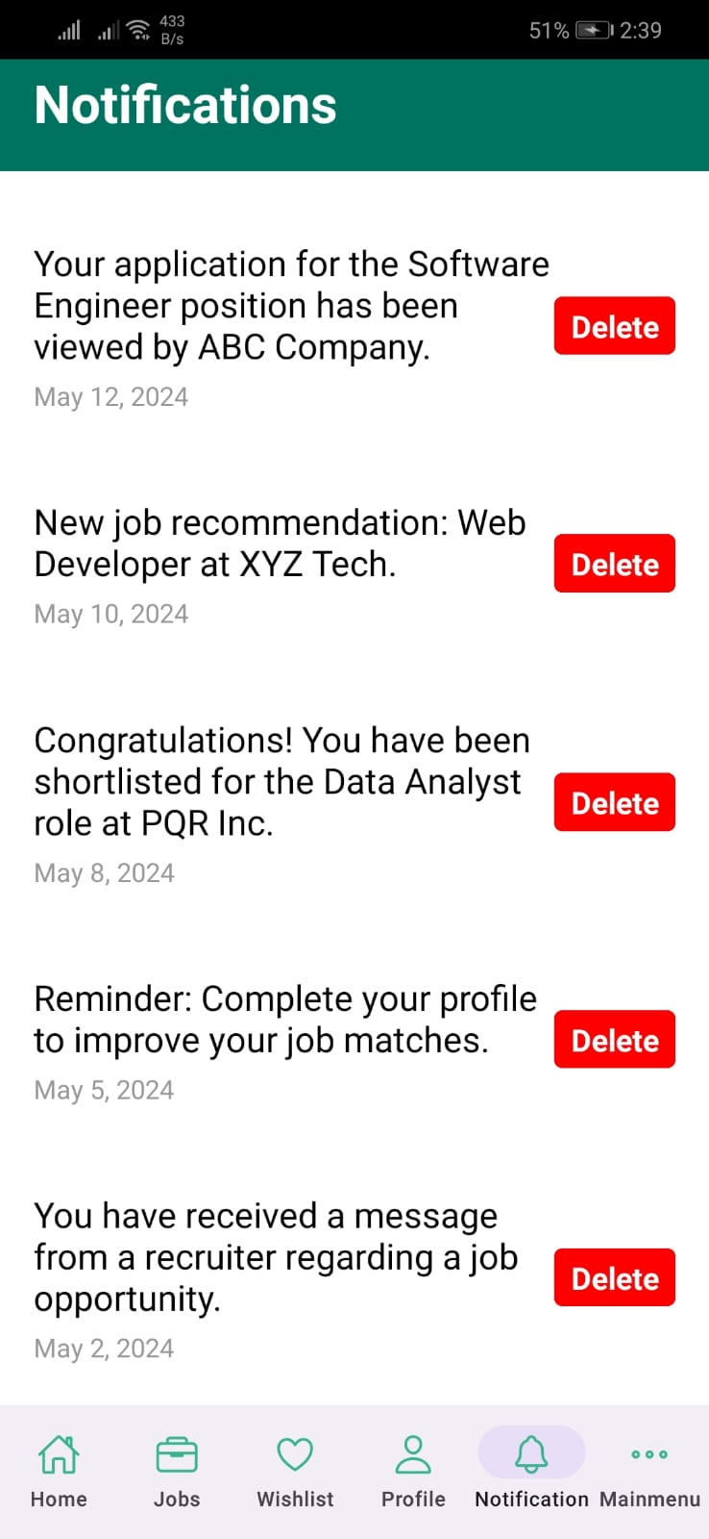
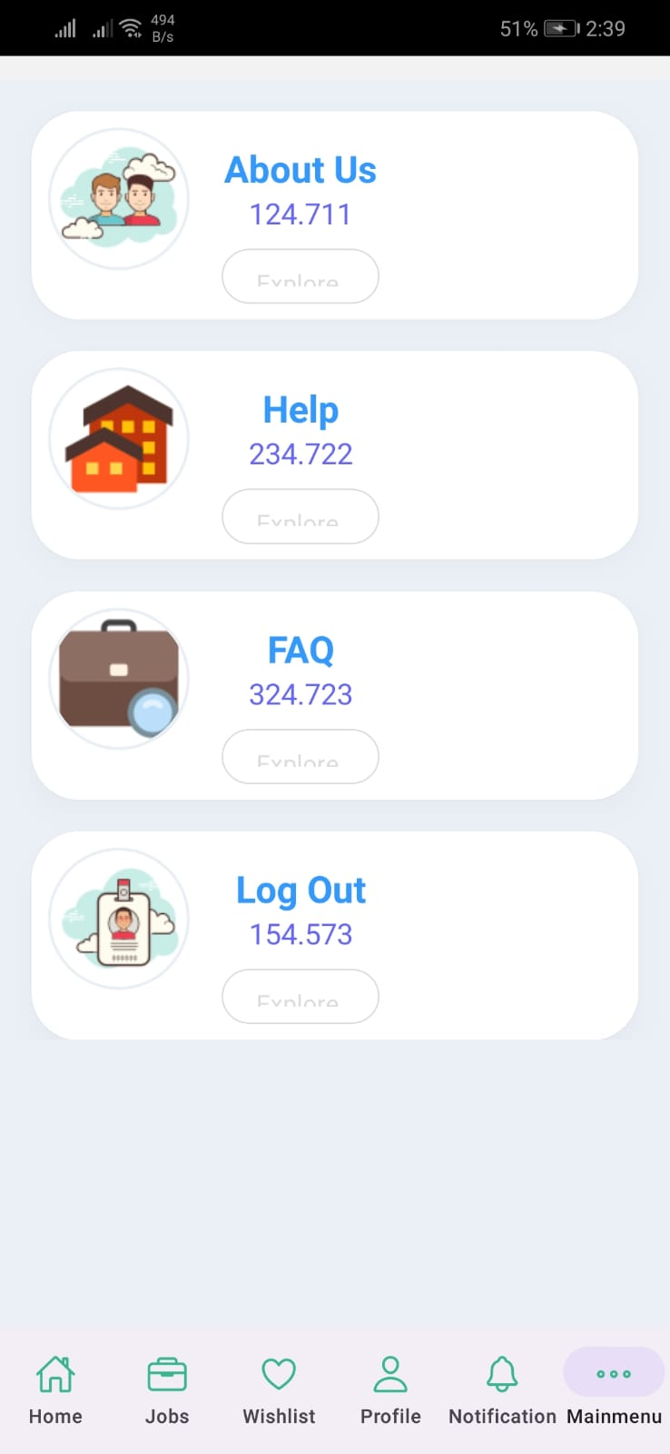

Slide 16
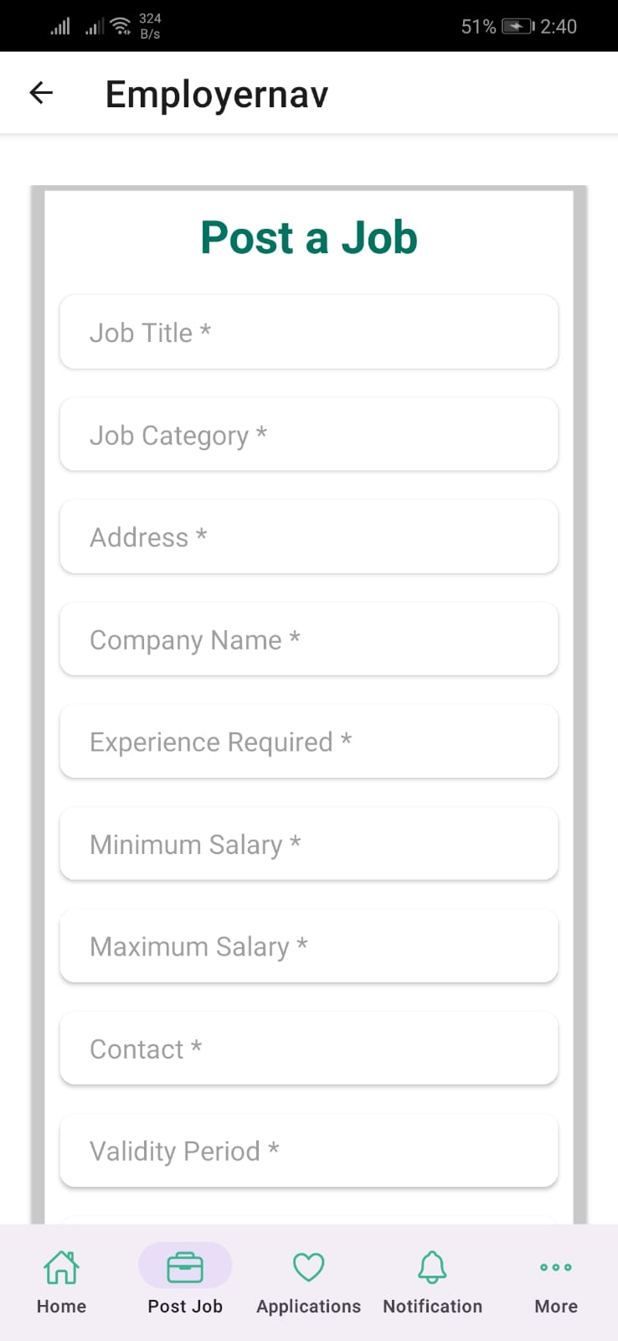
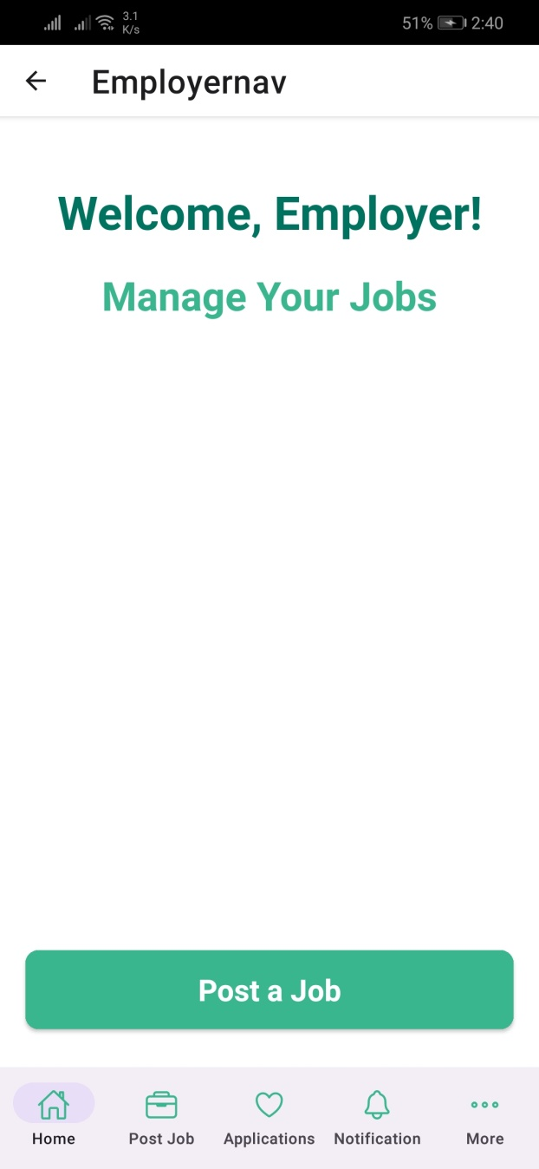

Slide 17
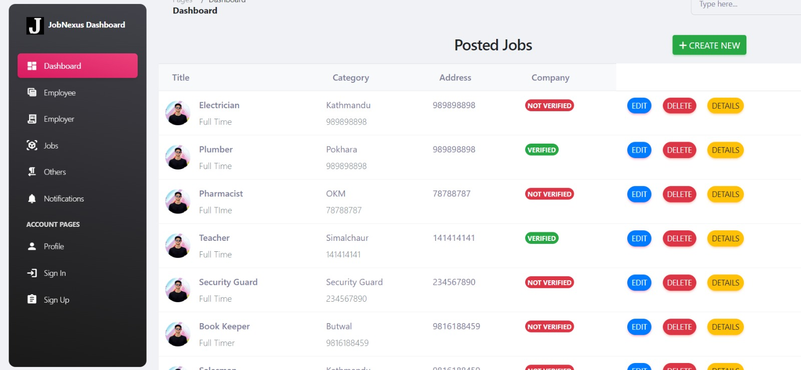

Slide 18
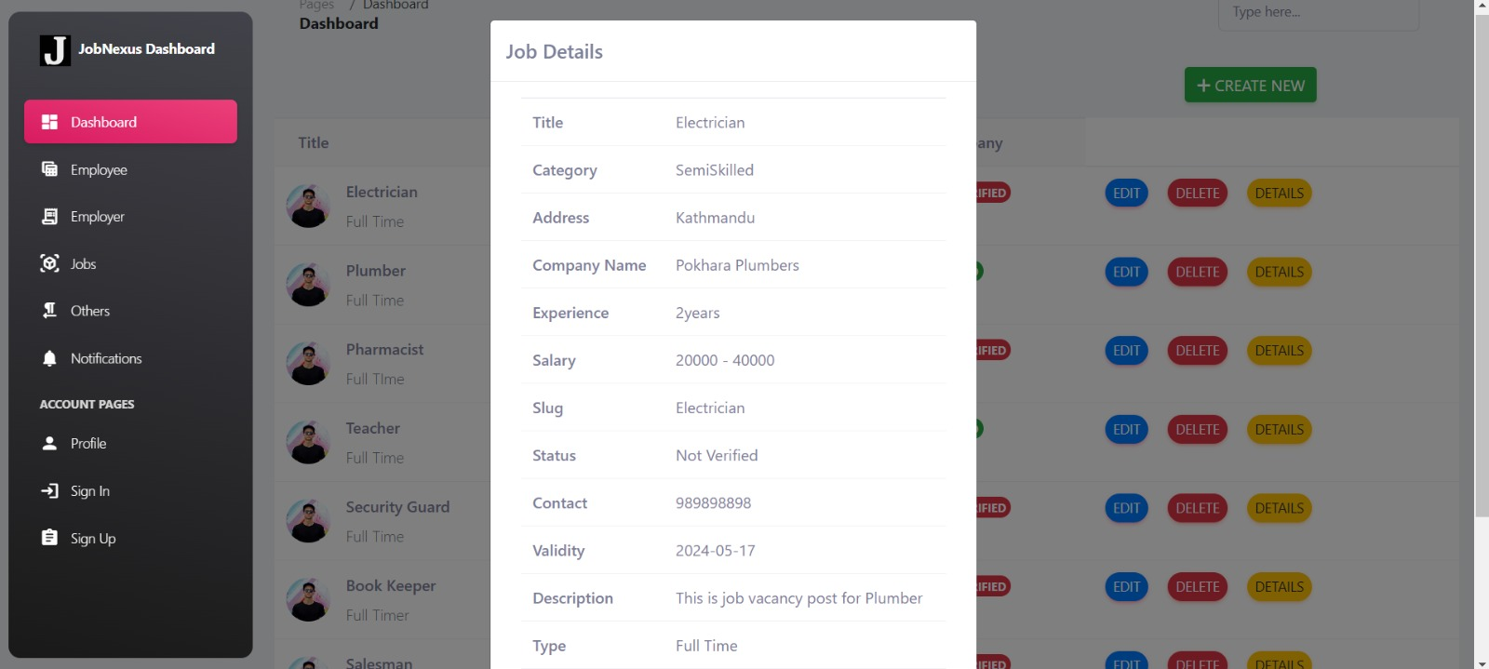

Slide 19
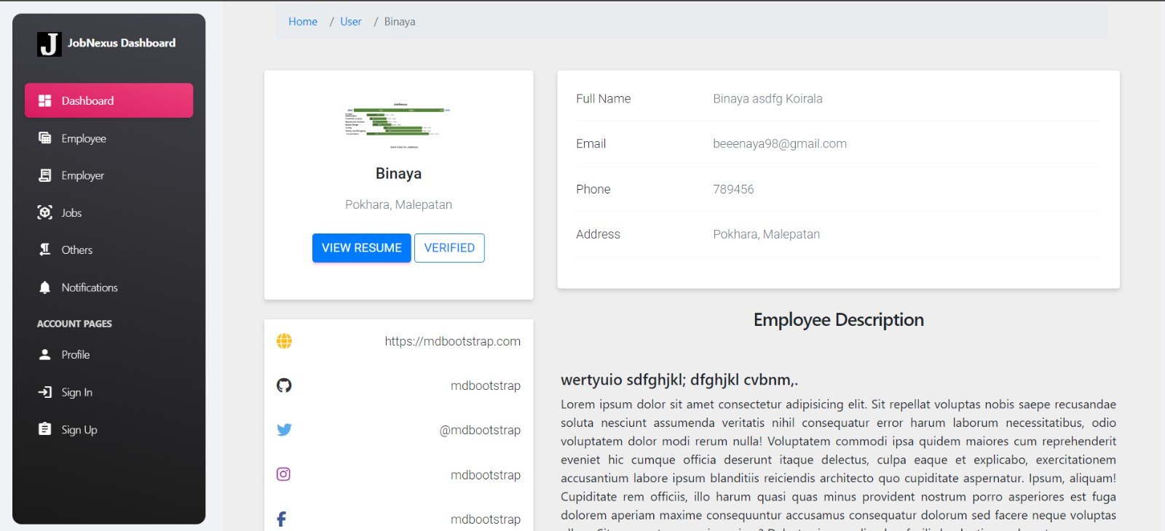

Slide 20
Thank You!! Any questions? :)

